Slide 1
3rabizi Language Identification
Detection of a Romanized Language from Short Social Media Texts

Slide 2
Contents
Motivation
Challenges
Preprocessing
Features
Result
Conclusion

Slide 3
Motivation
Language identification libraries do not handle Romanized languages as well as their official written language counterparts.
Romanized language: a language (typically a spoken dialect) that is transcribed or transliterated to Latin-based characters, often by way of smartphone keyboard use
Arabizi is widely used by Arabic speakers on SMS, Whats App, Twitter, etc.
Unlike Modern Standard Arabic (MSA), Arabizi does not have a sanctioned orthography.
Some conventions, such as letter substitutes, have arisen with uneven adoption.

Slide 4
Arabizi: Arabi-Inglizi (Arabic-English)
...also known as texting Arabic, Romanized Arabic, Latinized Arabic, Araby, Arabish
صباح ألخير!
9aba7 2l5air!
Good Morning!
هذا السؤال ل ما حدا بعرف جواب؟
hayda el so2al le ma hada by3rf jawebo?
Is this a question that no one knows the answer to?
S cannot follow th

Slide 5
Challenges in Arabizi language Identification
Arabizi (also called as Romanized Arabizi) is mainly dialectical, has non-standard spellings, no fixed grammars and a regional vocabulary sense usage.[1]
Very limited in terms of publicly available corpus.

Slide 6
Insufficient Data: Solutions
Corpus | Advantage | Disadvantage
Brown Corpus: Corpus containing million words curated in 1961. | Contains millions of English words | Created in 1961. Too old for our purpose.
Gutenberg Corpus: 25000 electronic books | Wide range of words can be included. Almost everything used in English. | Not domain(Chat application/web) specific
Web and Chat Text Corpus: Collected from Firefox discussion forum on review of PoC, wine in 2006. | Suits our need. | The corpus was made in 2006. The lingo has changed since.
Twitter Dataset: Custom made in 2019 that include specific topic Arab politics. | It suits our need, can be tailored to be more relevant and freshly made. | Only past 7 days of tweets can be fetched for free.

Slide 7
Twitter Data fetch
Create a Twitter Developer Account and get access to tokens.
Using the tokens and various Twitter APIs, fetch relevant tweets
Arabizi-English bitext corpus
Final corpus for the experiment
Preprocessing
Arabizi-English bitext corpus

Slide 8
Twitter Data Fetch

Slide 9
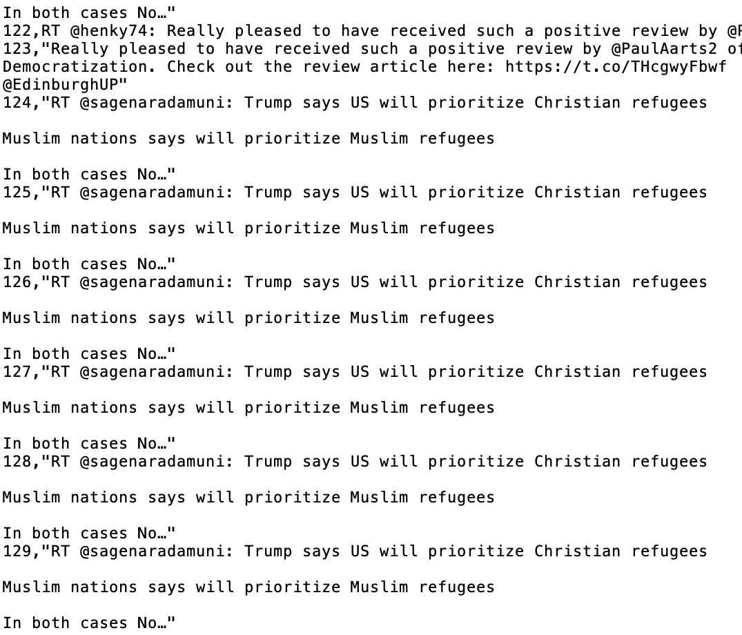
Challenges with Twitter Dataset
Repeated tweets: This will introduce a bias in training set.
Solution?

Slide 10
Preprocessing
Tweets containing keywords “Arab” and “Politics” were fetched to match the domain of existing corpus.
The fetched tweets were posted between 12/1/19 and 12/12/19.
The following function were carried as part of preprocessing:
Removal of retweets so as to remove repeated words
Removal of punctuation
Stripping new lines and spaces.
Removal of only numbers
Characters repeated more than two times consequently are limited to two.

Slide 11
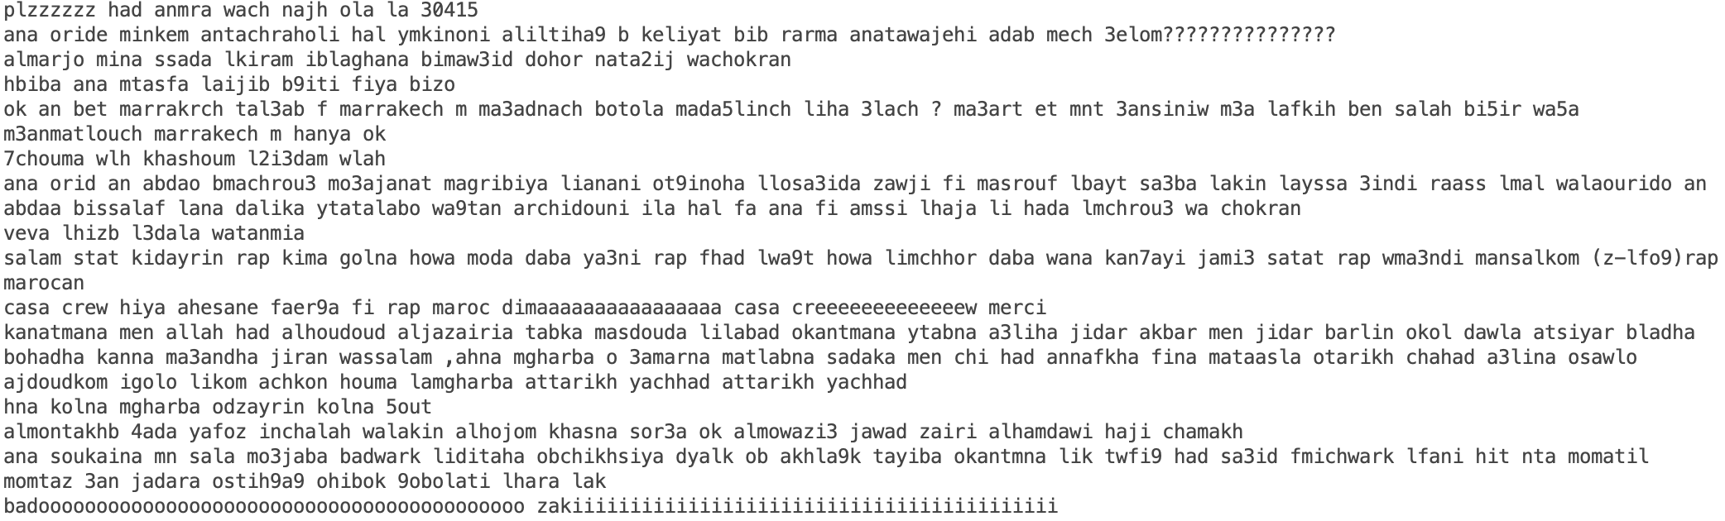
Removal of “Punctuation!!!!” Removal of Reepeated Characterssssss….

Slide 12
Features
Study by [1] found out that the increase in character level n-gram for the feature improved the accuracy. The best accuracy was at character level trigram.
The same study points at degraded accuracy on increase of word level n gram.
Character level Trigram
Word level Unigram
Inclusion of number

Slide 13
Algorithm

Slide 14
Results

Slide 15
Conclusion

Slide 16
References
[1] W. Adouane, N. Semmar, and R. Johansson, “Romanized berber and romanized arabic automatic language identification using machine learning,” in Proceedings of the Third Workshop on NLP for Similar Languages, Varieties and Dialects (VarDial3), pp. 53–61, 2016.
[2] K. Darwish, “Arabizi detection and conversion to arabic,” arXiv preprint arXiv:1306.6755, 2013.
[3] S. Malmasi and M. Dras, “Language identification using classifier ensembles,” in Proceedings of the Joint Workshop on Language Technology for Closely Related Languages, Varieties and Dialects, pp. 35–43, 2015.
[4] M. Al-Badrashiny and M. Diab, “Lili: A simple language independent approach for language iden- tification,” in Proceedings of COLING 2016, the 26th International Conference on Computational Linguistics: Technical Papers, pp. 1211–1219, 2016.
[5] W. Adouane, N. Semmar, R. Johansson, and V. Bobicev, “Automatic detection of arabicized berber and arabic varieties,” in Proceedings of the Third Workshop on NLP for Similar Languages, Varieties and Dialects (VarDial3), pp. 63–72, 2016.

